Slide 1
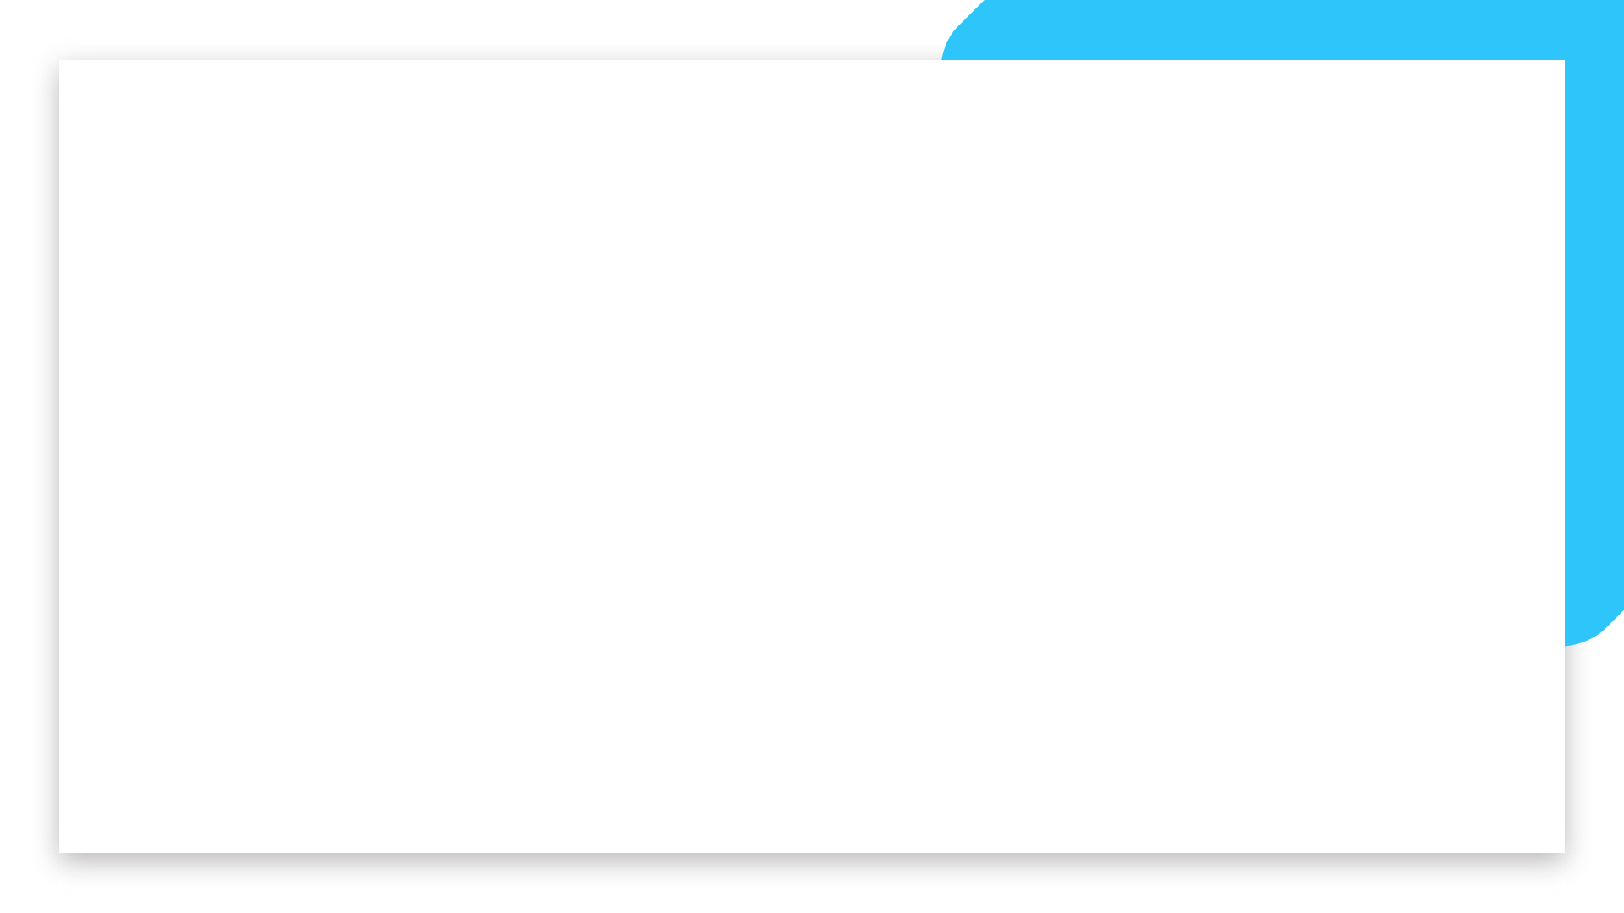


Data Science and Machine Learning
Generative AI - Multimodality

Slide 2
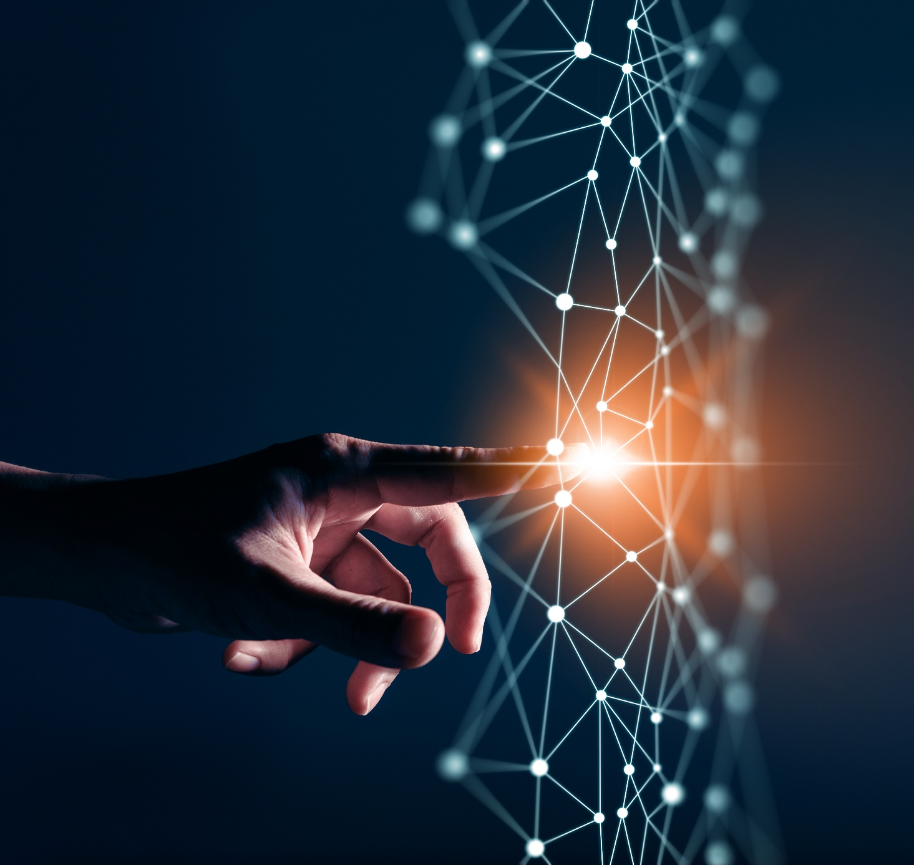
Image Generation and embedding

Slide 3
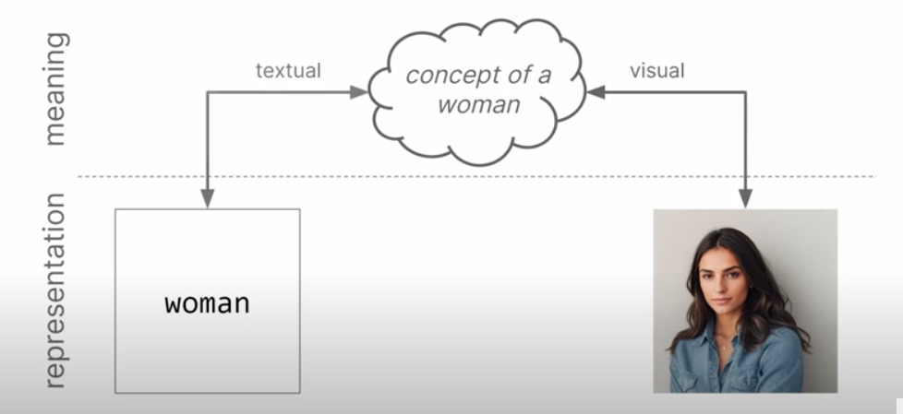
Generating Text and Images

Slide 4
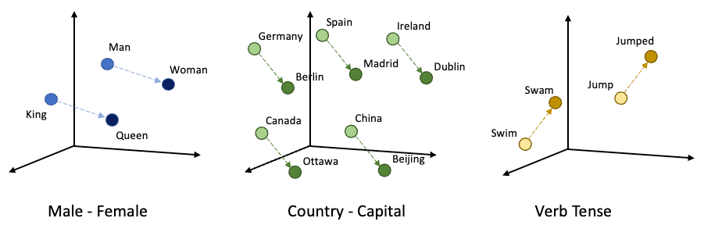
Generating Text and Images

Slide 5
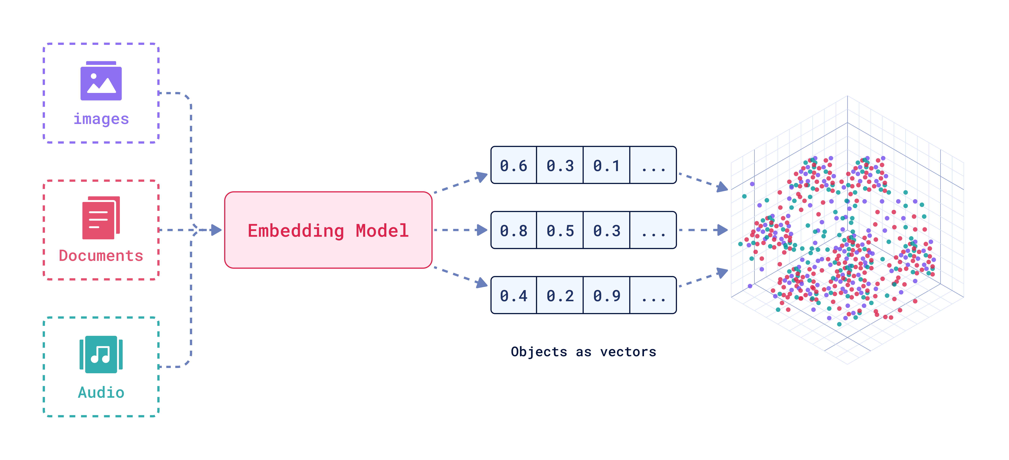
Generating Text and Images

Slide 6
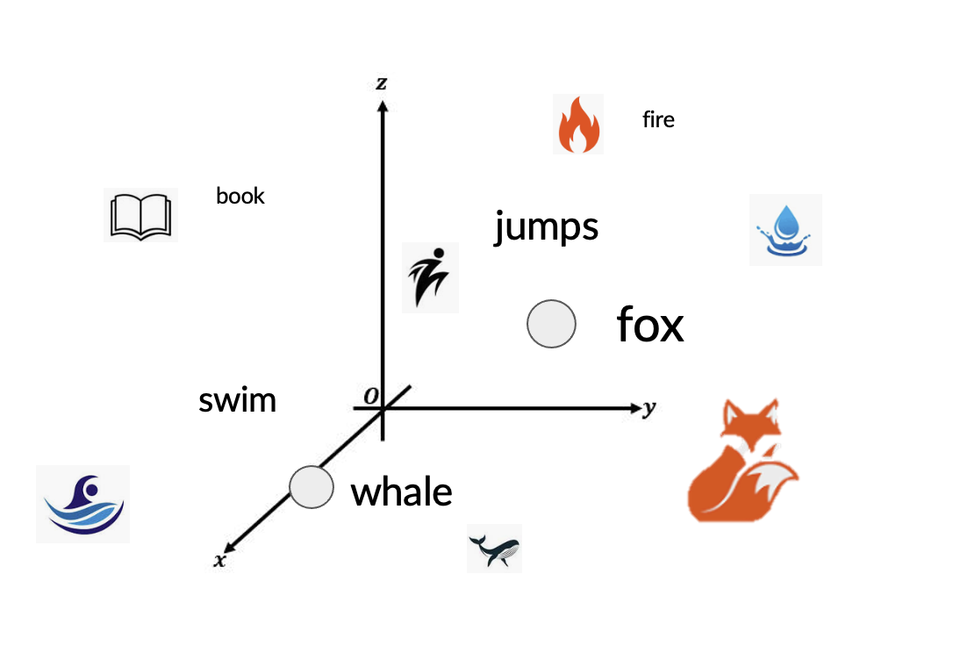
Generating Text and Images
Prompt:
“book”

Slide 7

Generating Text and Images
Prompt:

Slide 8
Lets code this out?

